Slide 1
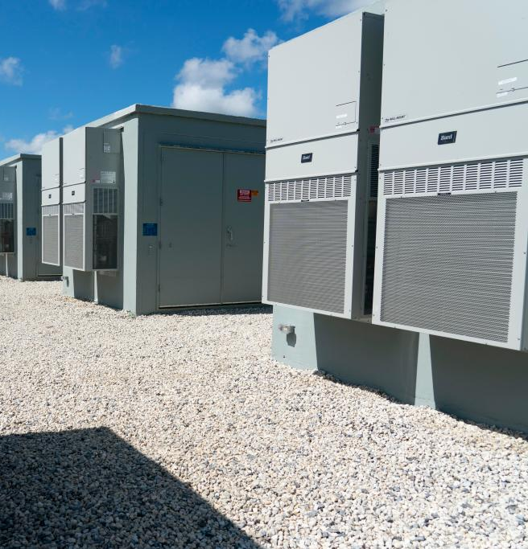
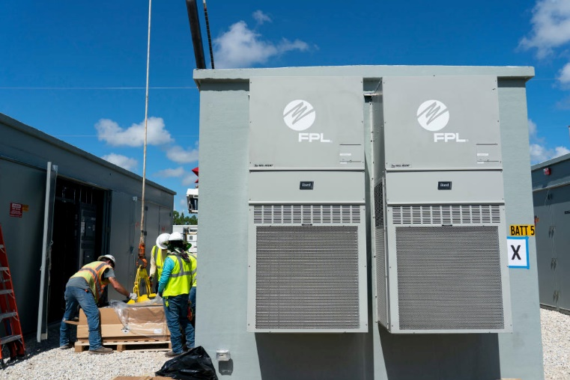
FPL Overview
Andrew Arana
Director Power Delivery Real Zero
Florida Power & Light Company
ERCOT IBRTF
Sep. 8, 2023

Slide 2
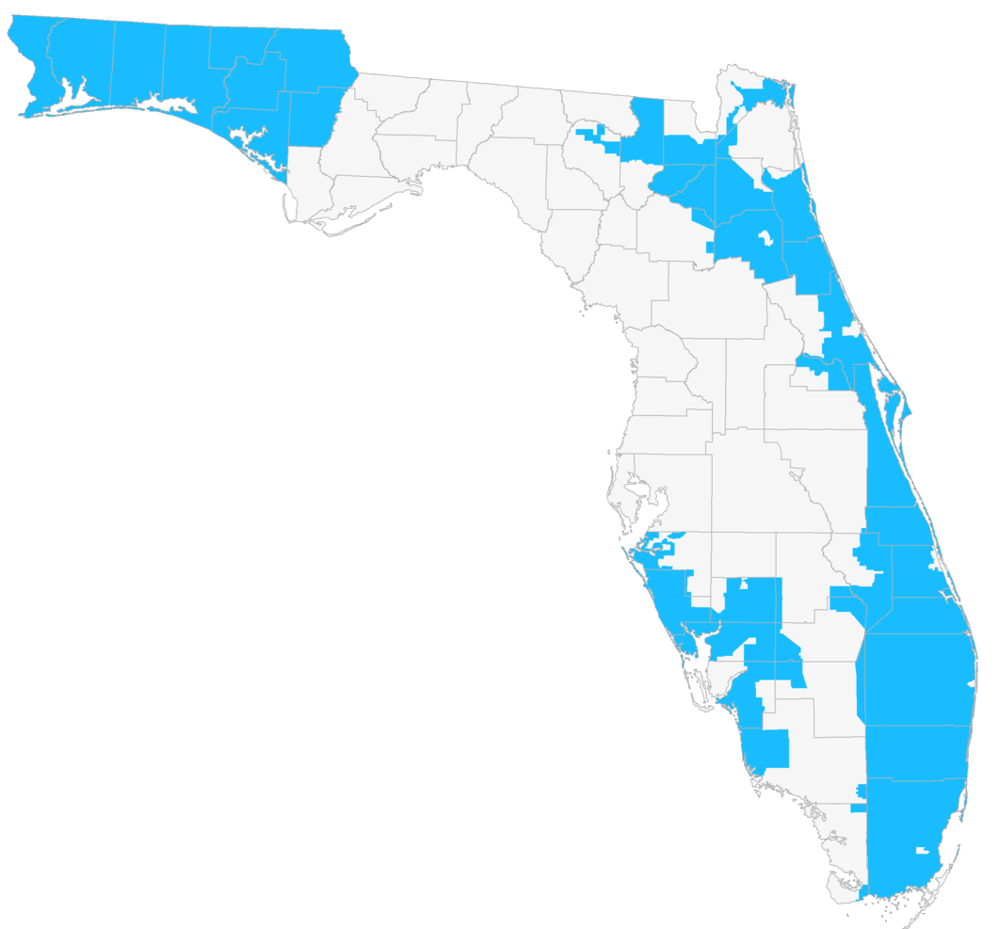
FPL is the largest utility in the state serving ~5.8 million customers across 43 counties
9,377 miles of transmission lines
78,822 miles of distribution lines
871 substations*
83,401 transmission structures
1.4 million distribution poles
1.1 million transformers
33,757 MW Generation Resources
4,479 MW Solar/500 MW BESS
System Peak Load ~27,000 MWhr
Balancing Authority/Transmission Operator functions for FPL
Reliability Coordinator agent for FRCC
*as of Dec. 31, 2022
FPL segment
service area
* (Infrastructure figures as of January 2023)

Slide 3
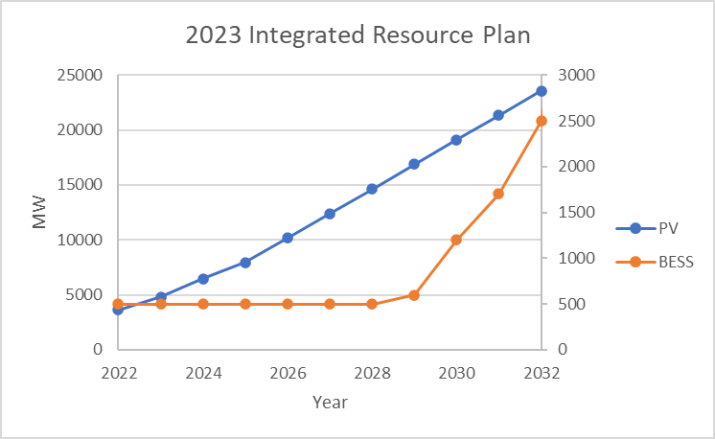
Florida Power & Light overview
FPL’s 2023 peak load demand: 27,700MW
In 2022, FPL delivered 26% of its energy from zero emission nuclear and solar, remainder was from natural gas
Transmission-connected PV will increase from 5GW at the end of 2023 to 23.5GW in 2032
Transmission-connected BESS will increase from 469MW in 2023 to 2.5GW in 2032
Our first green-hydrogen pilot will be commissioned in late 2023

Slide 4
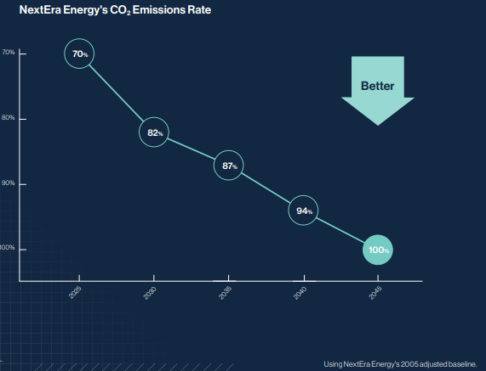
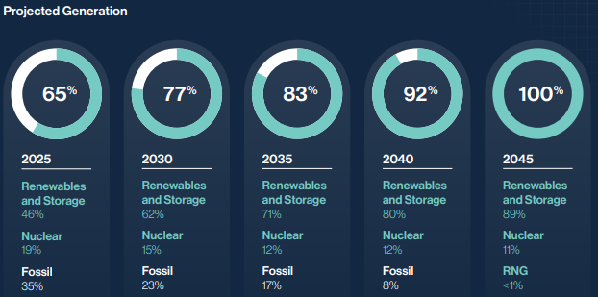
NextEra’s plan to reach Real Zero

Slide 5
Adoption of IEEE 2800
Previously, FPL developed facility interconnection requirements in response to system studies and NERC recommendations
Improve ride-through by addressing momentary cessation, instantaneous frequency tripping, etc.
This did not require significant retroactive plant upgrades
Requirement of additional monitoring and recording devices
FPL adopted IEEE 2800, excluding the last 2 chapters – monitoring and testing
Detailed technical design and performance specifications
Many vendors are familiar with IEEE 2800 and have started testing their equipment
Applicable to newly interconnecting IBR; it was not necessary or prudent to require wholesale retroactive upgrades
FPL will require testing and enforcement when IEEE 2800.2 is complete
Equipment manufacturers cannot certify compliance with all portions of IEEE 2800 until the testing standard is complete

Slide 6
Novel solutions to IBR weak-grid challenges
Grid-forming inverters may also be an effective solution
EPRI’s generic GFM models are effective for initial feasibility studies
138kV
2
1
230kV
230/138kV
560MVA
230/138kV
560MVA
Building additional transmission lines is an effective solution
Series compensation may also be a viable solution
Synchronous condensers improve system strength and stability
GFM Battery
BESS

Slide 7
Grid-forming inverters
With the addition of 2000MW of batteries over the next decade, the performance and benefits of GFM inverters must be assessed
The primary use cases will be to alleviate weak-grid impacts and improve resilience
The initial focus will be on GFM batteries, but benefits of GFM inverters at PV plants will also be explored
Simulations are required to determine the most effective way to deploy this technology
How many GFM inverters are required to ensure stability?
Some studies have suggested that 30% of inverters need to be GFM
Where should they be located for maximum effect?
GFM functional specifications and performance capabilities must be established in our interconnection requirements

